Slide 1

Git First Steps
xCITE Lab

Slide 2
Git Three States
Git has three main states that your files can reside in:
Committed: Means that the data is safely stored in your local repository. (You get here sing “git commit”)
Modified: Means that you have changed the file but have not committed it to your local repository yet. (You get here by using an ide like pycharm or emacs)
Staged: Means that you have marked a modified file in its current version to go into your next commit snapshot. (You get here by using “git add”)

Slide 3
Git workflow
You modify files in your working directory.
You stage the files, adding snapshots of them to your staging area.
You do a commit, which takes the files as they are in the staging area and stores that snapshot permanently to your local Git directory.

Slide 4
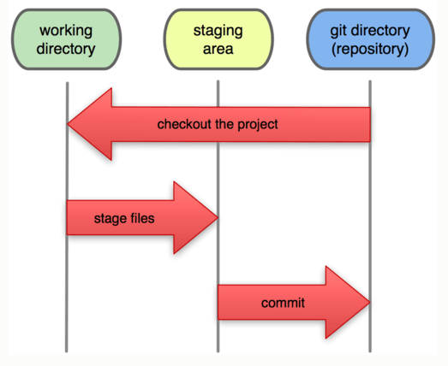
Git workflow

Slide 5
Before we start: Identifying yourself to git
In order to attach an author name to each activity, Git requires that you add your identity using configuration commands.
This means, every time you commit, the author attached to this commit will be you ! :)

Slide 6
Let’s add your name and email
git config --global user.name "[yourName]"
git config --global user.email "[yourEmail]"
For example
git config --global user.name "arnoldas500"
git config --global user.email "akurbanovas@albany.edu"

Slide 7
Create a Git repository
git init [repositoryName]
For example
git init EWES

Slide 8
Your Turn!
Create a new repository. It is up to you what you want to call your repository;
I like to follow the camel case (medial capital) naming convention. For instance, myProject.

Slide 9
Use the command: “ls -l”
Do you notice the new folder that was created?

Slide 10
Let’s create README.txt
Inside your folder project, create the file README.txt using emacs or your favorite editor.

Slide 11
Using emacs
cd EWES
emacs README.txt
Once the file opens,
add something about your project. for instance, “This is my first git repository”
Then, save and close the file (hint: ctr+x, ctr+s to save; ctr+x, ctr+c to exit)

Slide 12
Let’s see what happen!
git status

Slide 13
The “Untracked files”
The message we received means that we have files that are still not added to the version control system.
In other words, the files new to the local repository.

Slide 14
Let’s add the files!
git add README.txt

Slide 15
Let’s check the repository status again
git status

Slide 16
“Changes to be committed”
The message we received means that we have files that are ready to be included permanently in the local repository.
It lists the files that are staged and will be committed when we do git commit.

Slide 17
Let’s commit the files!
git commit -m "This is my first commit"

Slide 18
-m in git commit
The directive -m allows you to add a message to describe your commit.
This message is important when you look at the history, especially when more than one person is working on the same repository

Slide 19
Let’s check the repository status again
git status

Slide 20
Viewing the history of commands
git log

Slide 21
Try!
git log --stat
This will give you more information regarding the files that have been changed in each commit

Slide 22
Your Turn!
Go ahead and do more changes to the README.txt. Add the file and commit…
Do 3 more “add”s and 3 “commit”s

Slide 23
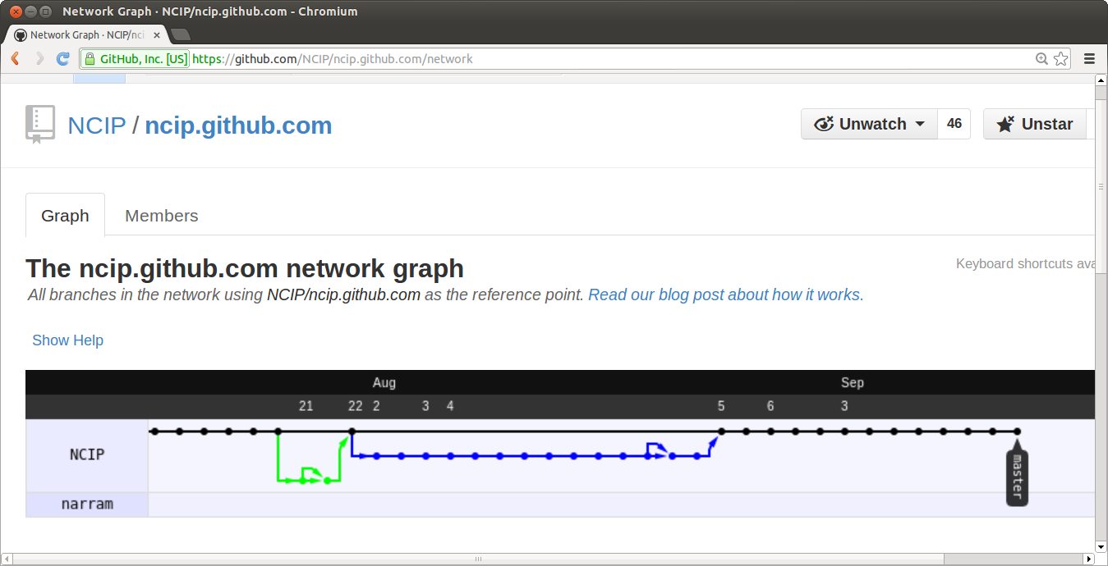
Git Branches on github.com !

Slide 24
Branching in Git
A branch in Git is simply a lightweight movable pointer to one of your commits.
The default branch name in Git is master.
As you initially create a repository, you’re given a master branch that points to the last commit you made.
Every time you commit in a branch, the pointer moves forward automatically.

Slide 25
To see which branch you are currently using:
git branch

Slide 26
To create a new branch:
git branch [newBranchName]
For example
git branch feature1

Slide 27
Let’s check the branches again:
git branch
Notice the new branch feature1; however the * is still on master. This means master is still the current branch

Slide 28
To switch to another branch:
git checkout [branchName]
For example
git checkout feature1

Slide 29
Let’s check the branches again:
git branch
So now feature1 is the new branch

Slide 30
Let’s see the differences between the two branches
In the following slides:
We’ll add and commit a file while in the branch feature1.
We’ll do “ls” to see the new file.
Then, we’ll switch back to the branch master.
Do “ls” again and notice how the file disappears.
Go back to the branch feature1
Do “ls” and notice the file that we added.

Slide 31
Make sure you’re in the branch “feature1”
git branch

Slide 32
Create a new file
emacs example1.txt
Add some text to this file!

Slide 33
Add the file and check the git status
git add example1.txt
git status

Slide 34
commit the file and and check the git status
git commit -m “Adding a file to learn about branches”
git status

Slide 35
Check the content of your project directory
ls -l
Do you see the file example1?

Slide 36
Switch to the branch “master” again
git checkout master

Slide 37
Make sure you’re at the branch “master”
git branch

Slide 38
Check the content of your project directory again
ls -l
Do you notice how the file example1 disappeared?

Slide 39
Switch to the branch “feature1” again
git checkout feature1

Slide 40
Check the content of your project directory one last time
ls -l
Do you notice the file example1?

Slide 41
Git branches
As a web developer, why do you think we need to use branches? How do you envision using them?

Slide 42
Git Merge
In the next step, you will merge back the “feature1” branch into the “master” branch!

Slide 43
Git Merge
In order to do that:
Check out the “master” branch (the one you want to merge into)
Do git merge [theBranchYouWantToMerge]

Slide 44
Git Merge
git checkout [theBranchYouWantToMergeWith]
git merge [theBranchYouWantToMerge]
For example
git checkout master
git merge feature1

Slide 45
Git Merge
After you do the merge,
the branch “master” will contain all the changes from the branch “feature1”.
Do “ls” and see!

Slide 46
Git: Delete a Branch
After you merge your changes, you don’t need the branch feature1
So let’s go ahead and delete it!

Slide 47
Deleting a Branch
git branch -d [theBranchYouWantToDelete]
For example
git branch -d feature1

Slide 48
Smile :)
You have just finished Level one! You are ready now to work in the collaborative mode :)

Slide 49
http://git-scm.com/book/en/Git-Branching-Basic-Branching-and-Merging
http://git-scm.com/book/en/Git-Branching-Branch-Management
http://git-scm.com/book/en/Git-Basics-Recording-Changes-to-the-Repository

Slide 50
References
http://git-scm.com/book

